Slide 1
Microsoft Project 2007
Getting Started

Slide 2
What is project 2007 & what it does for you
Project 2007 is a tool that help project manager to plan and track the project deliverables
Project 2007 helps you control…
  Project work
  Schedules
  Dependencies
  Finances
  Manage Project Team
  And many more thing…

Slide 3
Objective (getting started)
Get familiar with Project 2007 environment.
Create a project plan
Know general options to setup project environment
Learn about templates
Setup Project Calendar
Learn common view
Add tasks
Organize tasks
Know about task relationship
Link tasks

Slide 4
The Project 2007 Product Suite
Windows based application designed for single project manager
Provide all the features of standard 2007 and additionally provides enterprise level team planning and communication features when used with project server 2007
Project
Standard
2007
Project
Portfolio
Server
2007
Project
Professional
2007
Project
2007
Product
Suit
A portfolio management solution that helps organizations identify, select, manage and deliver portfolios that align with their strategies
Internet based solution that provides enterprise level project collaboration, time sheet reporting and status reporting features when used with project professional 2007
Project
Web Access
2007
Project
Server
2007
Provides and internet based interface to work with Project Server 2007 like timesheet entry interface.

Slide 5
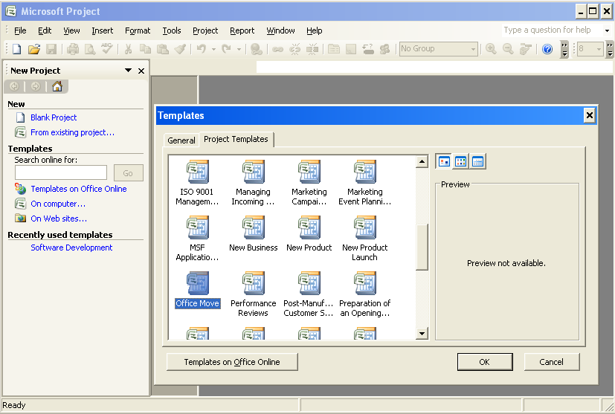
Create a New Project

Slide 6
Templates
Project 2007 provides standard templates that you can use to create your project plan.
The templates include the standard tasks that need to be carried out to complete a project.
These tasks vary based on the type of project.
You can select a template that best suits the project on which you are working.
You can create your own templates
Organizations often create templates with standard high level WBS/list of activities that are common in all projects
Activity: Modify an existing template and save as My-Template

Slide 7
Create a New Project
When you create a project plan,
  You need to know start date of the project, the finish date of the project, or both.
  Project 2007 automatically calculates the other date after you specify one of the dates
It is always a good practice to specify the start date when creating the project plan

Slide 8
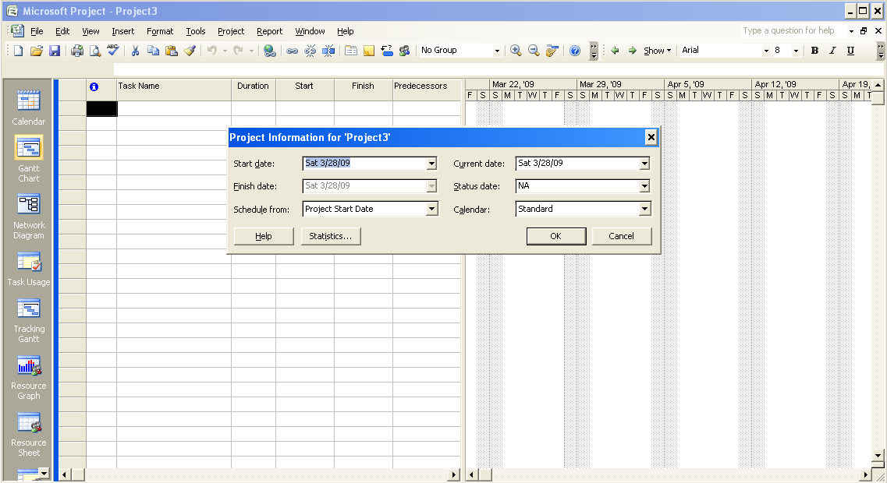
Create a New Project

Slide 9
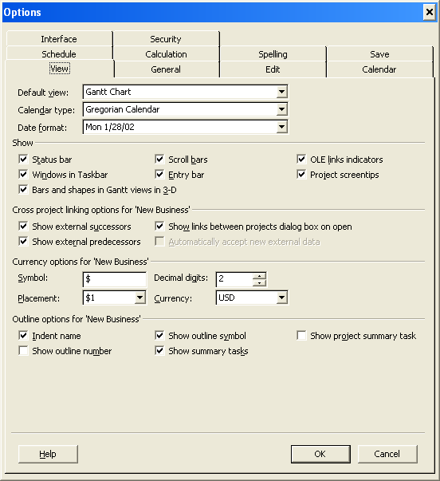

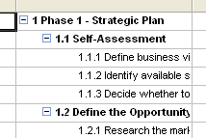
Create a New Project
Specifies whether you want to display a project-level summary task, which would have an ID of 0
If checked, project name is displayed as top most summary task at level 0
Indents the names of subtasks in the Task Name column.
If you clear this check box, tasks that have subtasks are hidden from view

Slide 10
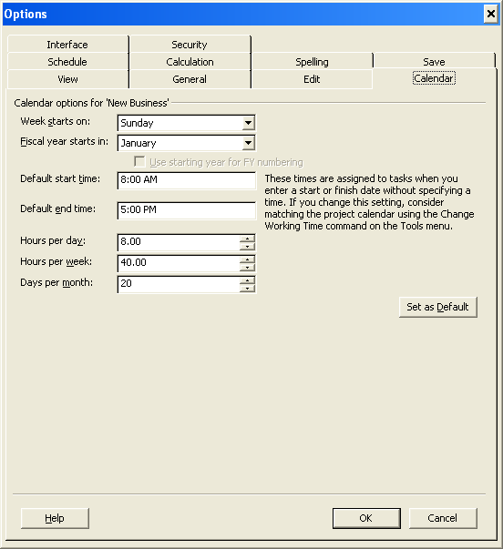
Create a New Project

Slide 11
Revisit Objectives
Get familiar with Project 2007 environment.
Create a project plan
Know general options to setup project environment
Learn about templates
Setup Project Calendar
Learn common view
Add tasks
Organize tasks
Know about task relationship
Link tasks

Slide 12
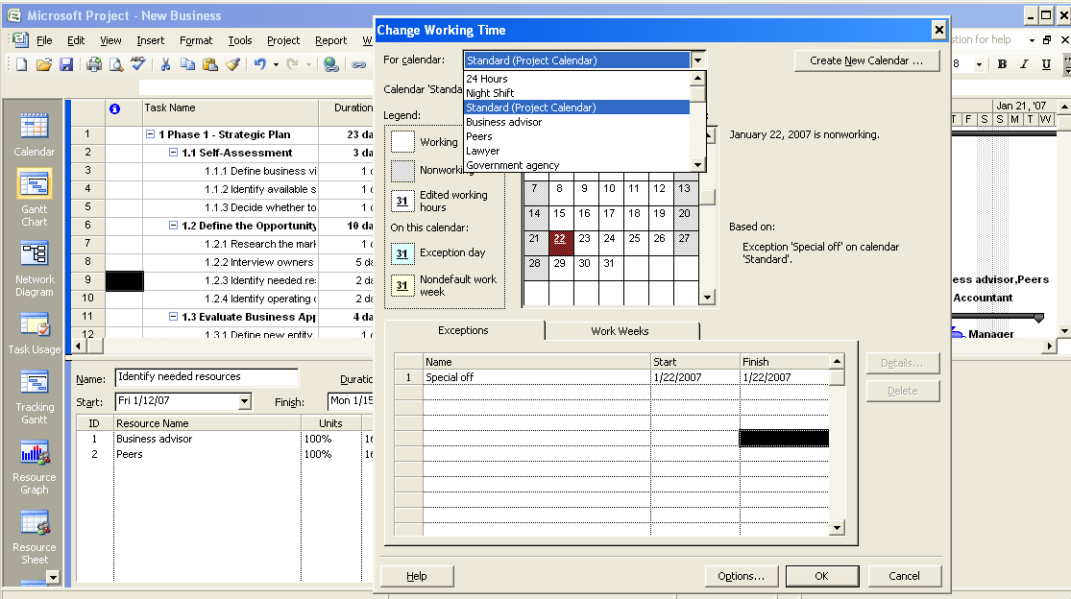
Set Up the Project Calendar
3 Base Calendar
Resource Calendars
Create a New Calendar
Enter specific non working days

Slide 13
Set Up the Project Calendar
A project calendar defines the general working and nonworking time for tasks and resources.
Set Up the Project Calendar
  To specify the nonworking hours for the project, click Tools, and then click Change Working Time.
  To select a base calendar for the project, in the For calendar box, click the down arrow.
  To set the Standard base calendar as the project calendar, in the list, click Standard (Project Calendar).
  To set a nonworking day, in the Exceptions tab, click in the Name field, type Special Off and then click in the Start field.
  To set the date for the nonworking day, in the Start field, type 1/22/2007 and then press ENTER.
  To close the Change Working Time dialog box, click OK.
  To verify the change made to the project calendar, in the right pane, scroll to the right to the week indicated by Jan 22, ‘07.

Slide 14
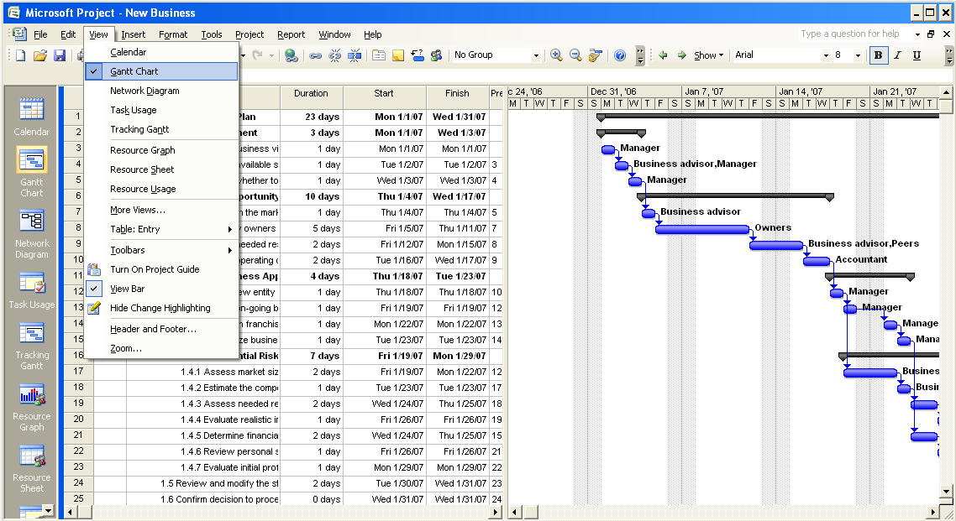
Working with views
Default View

Slide 15
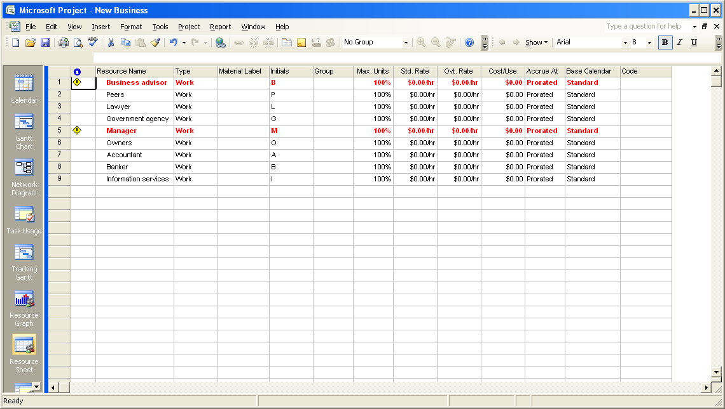
Working with views

Slide 16
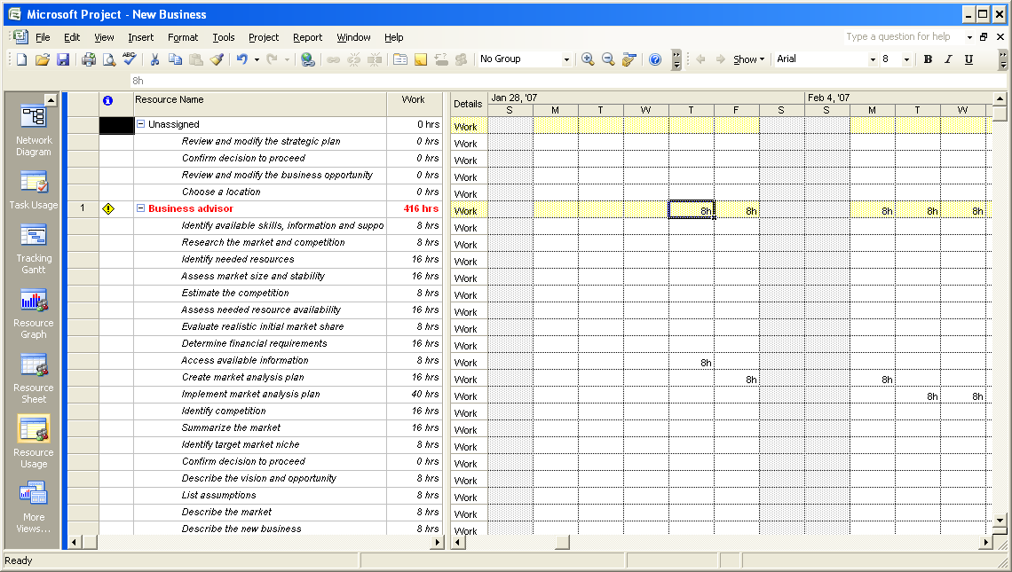
Working with views

Slide 17
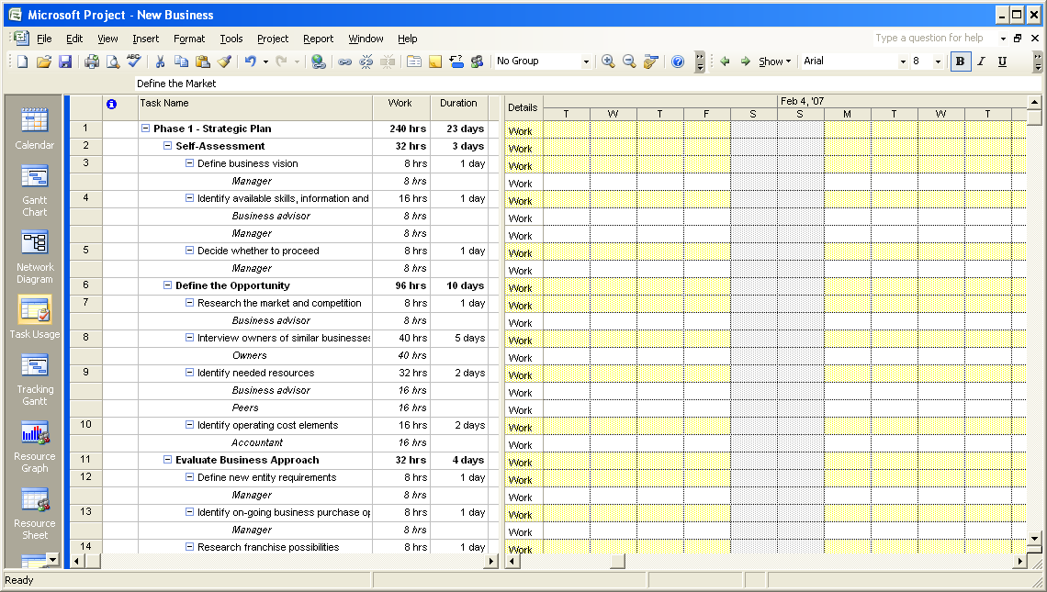
Working with views

Slide 18
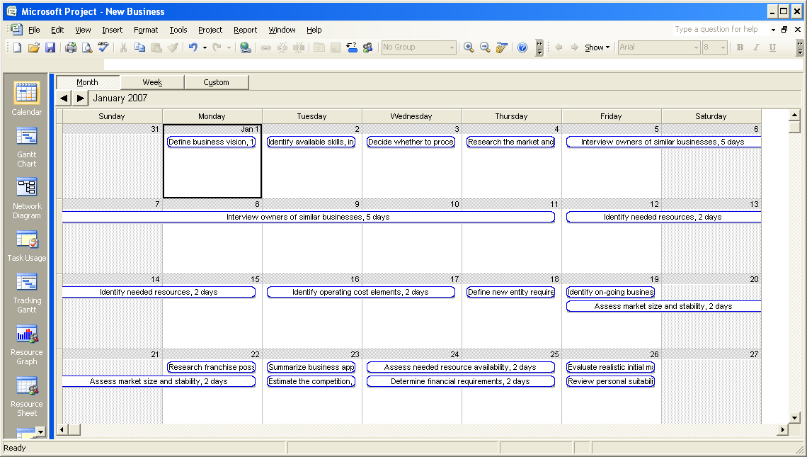
Working with views

Slide 19
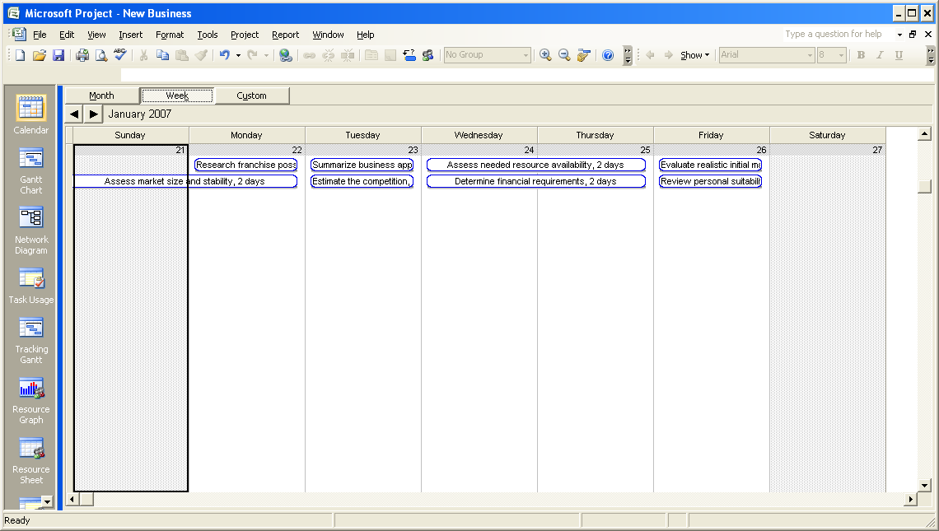
Working with views

Slide 20
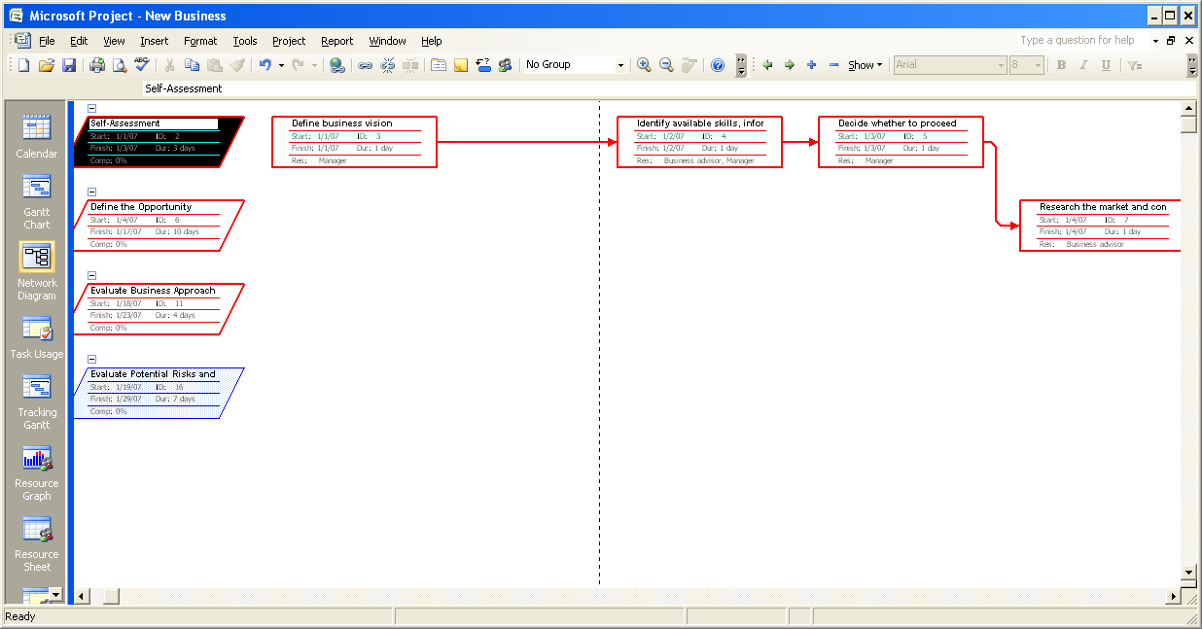
Working with views

Slide 21
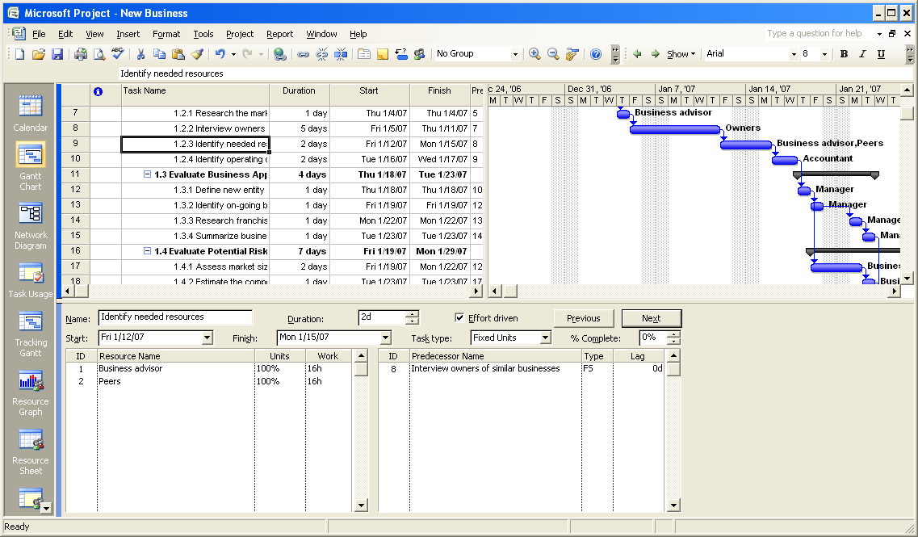
Working with views
Combination View Views → More Views → Task Entry

Slide 22
Question
You have been assigned a critical project that needs to be completed in a limited number of hours. Therefore, you need to extend the working hours and working days for this project. You want to set the working hours for your project as Monday to Saturday, 8.30 A.M. to 5.30 P.M., with a one-hour lunch break. Which of the following base calendars will you use?
Select the one best answer.
  24 Hours base calendar.
  Night Shift base calendar.
  Standard base calendar.
  New custom base calendar.
Correct answer is 4.
You must create a new custom base calendar because the base calendars included with Project 2007 are not suitable for the specified working hours.

Slide 23
Revisit Objectives
Get familiar with Project 2007 environment.
Create a project plan
Know general options to setup project environment
Learn about templates
Setup Project Calendar
Learn common view
Add tasks
Organize tasks
Know about task relationship
Link tasks

Slide 24
Adding Tasks to a Project
When you add a task,
  For every new task you add, Project 2007 assigns a duration of one day.
  The question mark in the Duration column indicates that this is an estimated duration.
  The Gantt Chart displays a corresponding task bar of one day’s length.
  By default, the start date of the task is set to the start date of the project.
  The task is automatically assigned an ID number. This ID number is unique to each task.
  However, the ID number does not necessarily represent the order in which the tasks occur.

Slide 25
Task notes
Task notes provide addition information about the task. Often it is an information that is required to perform the task or it helps performing the tasks
Adding task notes
  In the project plan, select the task for which you want to provide additional information.
  On the Project menu, click Task Notes.
  In the Task Information dialog box, in the Notes box, type the required information, and then click OK. A note icon appears in the Indicators column for the selected task.
  In the Indicators column, point to the note icon. The note appears as a ScreenTip. If you cannot view the entire note, double-click the note icon to display the complete note.
  To create a hyperlink to additional information, select a task, and then on the Insert menu, click Hyperlink. Alternatively, you can click the Insert Hyperlink button on the Standard toolbar, or right-click the task name and click Hyperlink on the shortcut menu.
  In the Insert Hyperlink dialog box, in the Text to display box, type the text that will appear as a hyperlink.
  In the Address box, type the location of the file or the URL of the page on the Internet or the intranet, and then click OK. A hyperlink icon appears in the Indicators column for the selected task.
  In the Indicators column, point to the hyperlink icon. The descriptive text that you specified when you created the hyperlink appears as a ScreenTip.
  Click the hyperlink icon to open the specified Web page or file.

Slide 26
Working with Tasks
Task duration.
Add task duration.
Describe milestones.
Organize tasks by creating summary tasks and subtasks.
Describe how tasks can be linked with each other.
  Finish-to-start (FS)
  Start-to-start (SS)
  Finish-to-finish (FF)
  Start-to-finish (SF)
Link tasks and calculate the project duration.

Slide 27
Task duration
Time Duration Abbreviation
  Minute – ‘m’ appears as min in the project plan
  Hour – ‘h’ appears as hr in the project plan
  Day – ‘d’ appears as day in the project plan
  Week – ‘w’ appears as wk in the project plan
  Month – ‘mo’ appears as mon in the project plan
To specify the durations for days, weeks, and months, go to:
Tools → Options → Calendar Tab

Slide 28
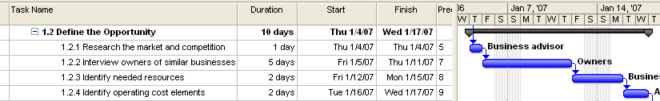
Specifying task duration
For efficient project management, it is a good practice to specify the task durations ranging from eight hours (one day) to 80 hours (10 days). Tasks that require less than one day for completion will be too granular, while tasks that require more than 10 days to complete might be too long to be managed properly.

Slide 29
Question
You have been assigned the project of creating small animations. One of the tasks involved in this project is to record the audio required for the animations by using a voice-over artist. A list of selected voice-over artists has been posted on the intranet. You need to provide this list of voice-over artists to the team member who will record the audio. How will you provide this information in your project plan?
Select the one best answer.
  Create a task for sending a contract to the voice-over artist and provide a hyperlink to the list of voice-over artists on the intranet.
  Create a task for sending a contract to the voice-over artist and provide the list of voice-over artists in the Task Information page.
  Create a task for sending a contract to the voice-over artist.
Option 1 is correct:
You must create a task for sending a contract to the voice-over artist and provide a hyperlink to the list of voice-over artists on the intranet.

Slide 30
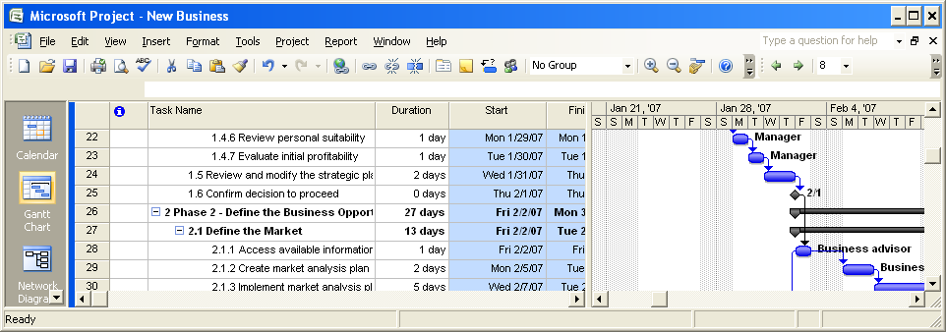
Milestone
Milestones indicate important events of your project. For example, a milestone can indicate the end of one phase of the project
A milestone is represented as a task with zero duration because the milestone usually does not involve any work.

Slide 31
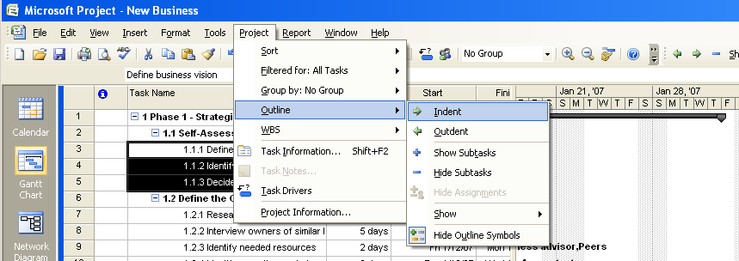
Summary and Sub tasks
Select the tasks that you want to group into a phase, and then indent the tasks. The task that appears before the first indented task becomes the summary task. The summary task name is formatted in bold and a summary task bar appears in the Gantt Chart. Project 2007 calculates the duration of a summary task as the period between the start date of the subtask that is scheduled to start first and the finish date of the subtask that is scheduled to finish last.
Summary Task
Sub Tasks

Slide 32




Task Relationship
Projects often require that the tasks be performed in a specific order.
  The second task must occur later than the first task. This relationship is called sequence.
  The second task can occur only if the first task is completed. This relationship is called dependency.
  First task is call predecessor and second task is called successor
There are 4 type of relationship
  Finish to start (FS)
    Indicates that the finish date of the predecessor task determines the start date of the successor task.
  Start to start (SS)
    Indicates that the start date of the predecessor task determines the start date of the successor task.
  Finish to finish (FF)
    Indicates that the finish date of the predecessor task determines the finish date of the successor task.
  Start to finish (SF)
    Indicates that the start date of the predecessor task determines the finish date of the successor task.

Slide 33
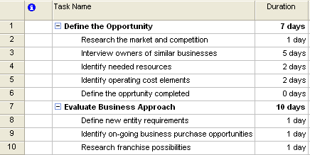
Lab: Linking Tasks
Create a new project
Create following list of activities

Slide 34
Lab: Linking Tasks
To create a link between task 2 and task 3, click to select task 2, hold down the SHIFT key, and then click task 3.
Click Edit, and then click Link Tasks.
To create another task relationship, click to select task 3, hold down SHIFT, and then click task 6.
Click Edit, and then click Link Tasks.
To link tasks by using the Task Information dialog box, click to select task 9, click Project, and then click Task Information.
In the Task Information dialog box, click the Predecessors tab.
In the Predecessors table, click the first row in the Task Name column, and then click the down arrow.
To set the predecessor for this task as task 8, in the list, click Define new entity requirements, and then press ENTER.
Click OK to close the Task Information dialog box.

Slide 35
Lab: Linking Tasks
To link task 9 and task 10, click to select task 9, hold down SHIFT, and then click task 10.
Click Edit, and then click Link Tasks.
To link the two summary tasks, select task 1, hold down the CTRL key, and then select Task 7.
Click Edit, and then click Link Tasks.
To calculate the project duration, click Project, and then click Project Information.
To view more details of the duration information, in the Project Information for ‘Linking Tasks’ dialog box, click Statistics.
To close the Project Statistics for ‘Linking Tasks’ dialog box, click Close.
To view the project duration in the Gantt Chart view, click View, and then click Zoom.
To change the timescale in the Gantt Chart view, in the Zoom dialog box, click to select the Entire project option, and then click OK.

Slide 36
Questions
You have created a project plan for your project. For this project, Task 10 must start when Task 5 finishes and Task 10 must finish when Task 7 finishes. What relationship will you specify between these tasks?
FS relationship from Task 10 to Task 5 and FF relationship from Task 10 to Task 7.
FS relationship from Task 5 to Task 10 and FF relationship from Task 10 to Task 7.
FS relationship from Task 10 to Task 5 and FS relationship from Task 7 to Task 10.
SF relationship from Task 5 to Task 10 and FF relationship from Task 10 to Task 7.
Option 2 is correct.
You must specify an FS relationship from Task 5 to Task 10 and an FF relationship from Task 10 to Task 7.

Slide 37
Questions
In your project plan, you have added a task with the duration of 0d. What is this task called?
  Predecessor.
  Successor.
  Milestone.
  Summary task.
  Subtask
Option 3 is correct
A milestone is a task with the duration of zero days.

Slide 38
Revisit Objectives
Get familiar with Project 2007 environment.
Create a project plan
Know general options to setup project environment
Learn about templates
Setup Project Calendar
Learn common view
Add tasks
Organize tasks
Know about task relationship
Link tasks

